Slide 1
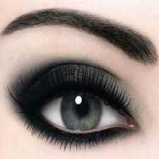

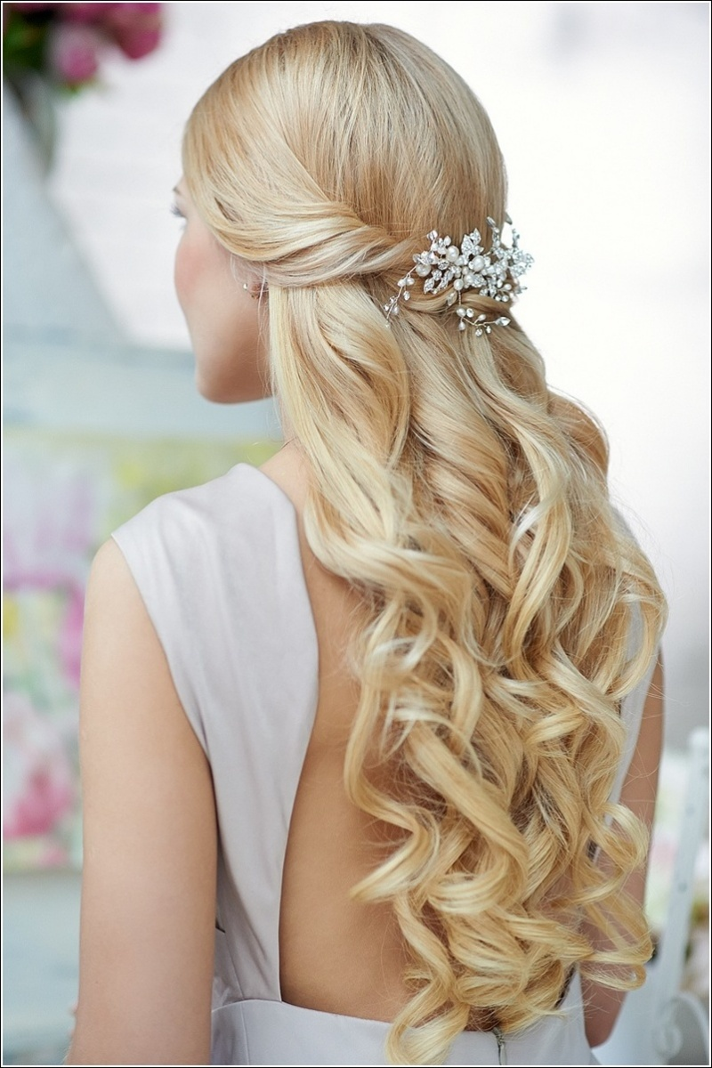
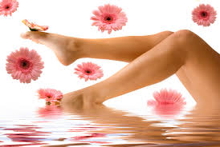
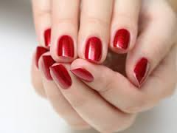
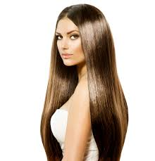
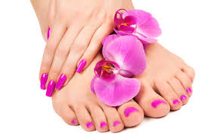
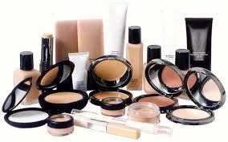
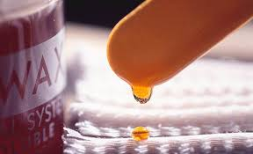
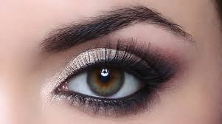

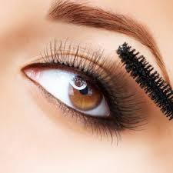
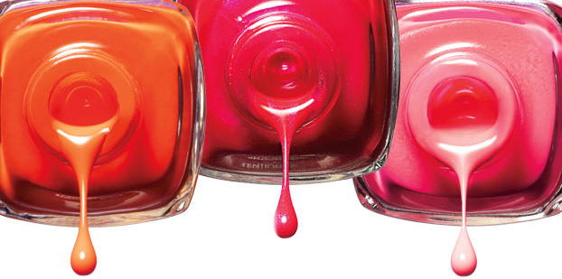

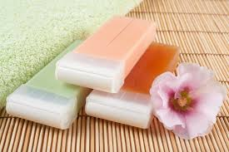
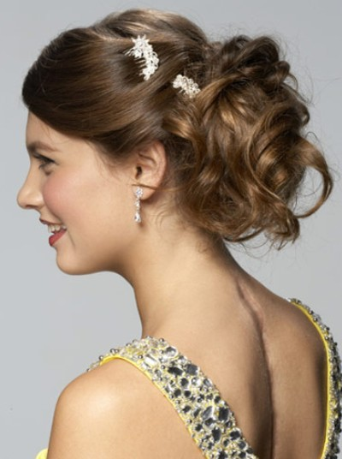
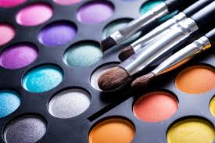
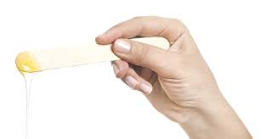
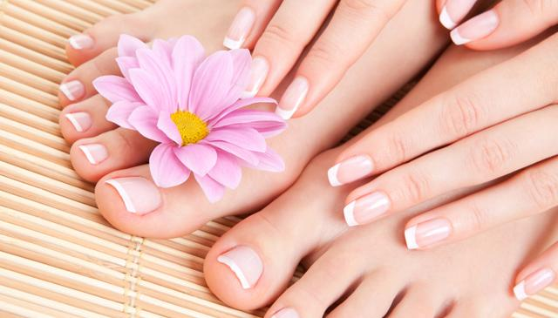
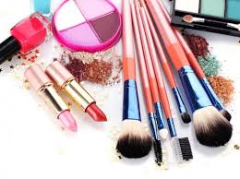
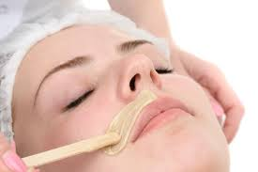

Slide 2
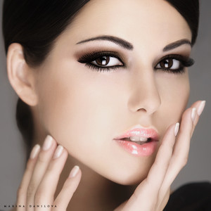
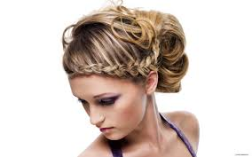
What is BeautyFit?
BeautyFit is an online platform that connects beauty professionals with customers through a website or App.
We offer convenient prices, great quality, and adapt to your schedule
Beauty Professionals will go to your home at the time of your preference
Services Offered
Nails
Makeup
Hair Styling
Waxing

Slide 3



A Problem? We have the Solution!
Beauty services are expensive
BeautyFit offers convenient Prices
Salons close too early
BeautyFit adapts to your schedule
The Salon is too far
BeautyFit comes to your home or wherever you want

Slide 4

Who has the problem?
Young women, from 18 to 35 y.o.
Market size:
Boston: 102,605 women between 18 and 35 y.o.
U.S.A: 16,500,000 in top 20 US metropolitan areas between 18 and 35 y.o.
Notes:
Statistics taken from https://suburbanstats.org/population/massachusetts/how-many-people-live-in-Boston
And from https://www.census.gov/population/age/data/2012comp.html

Slide 5
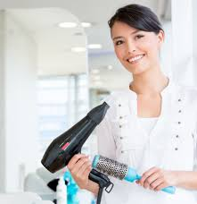


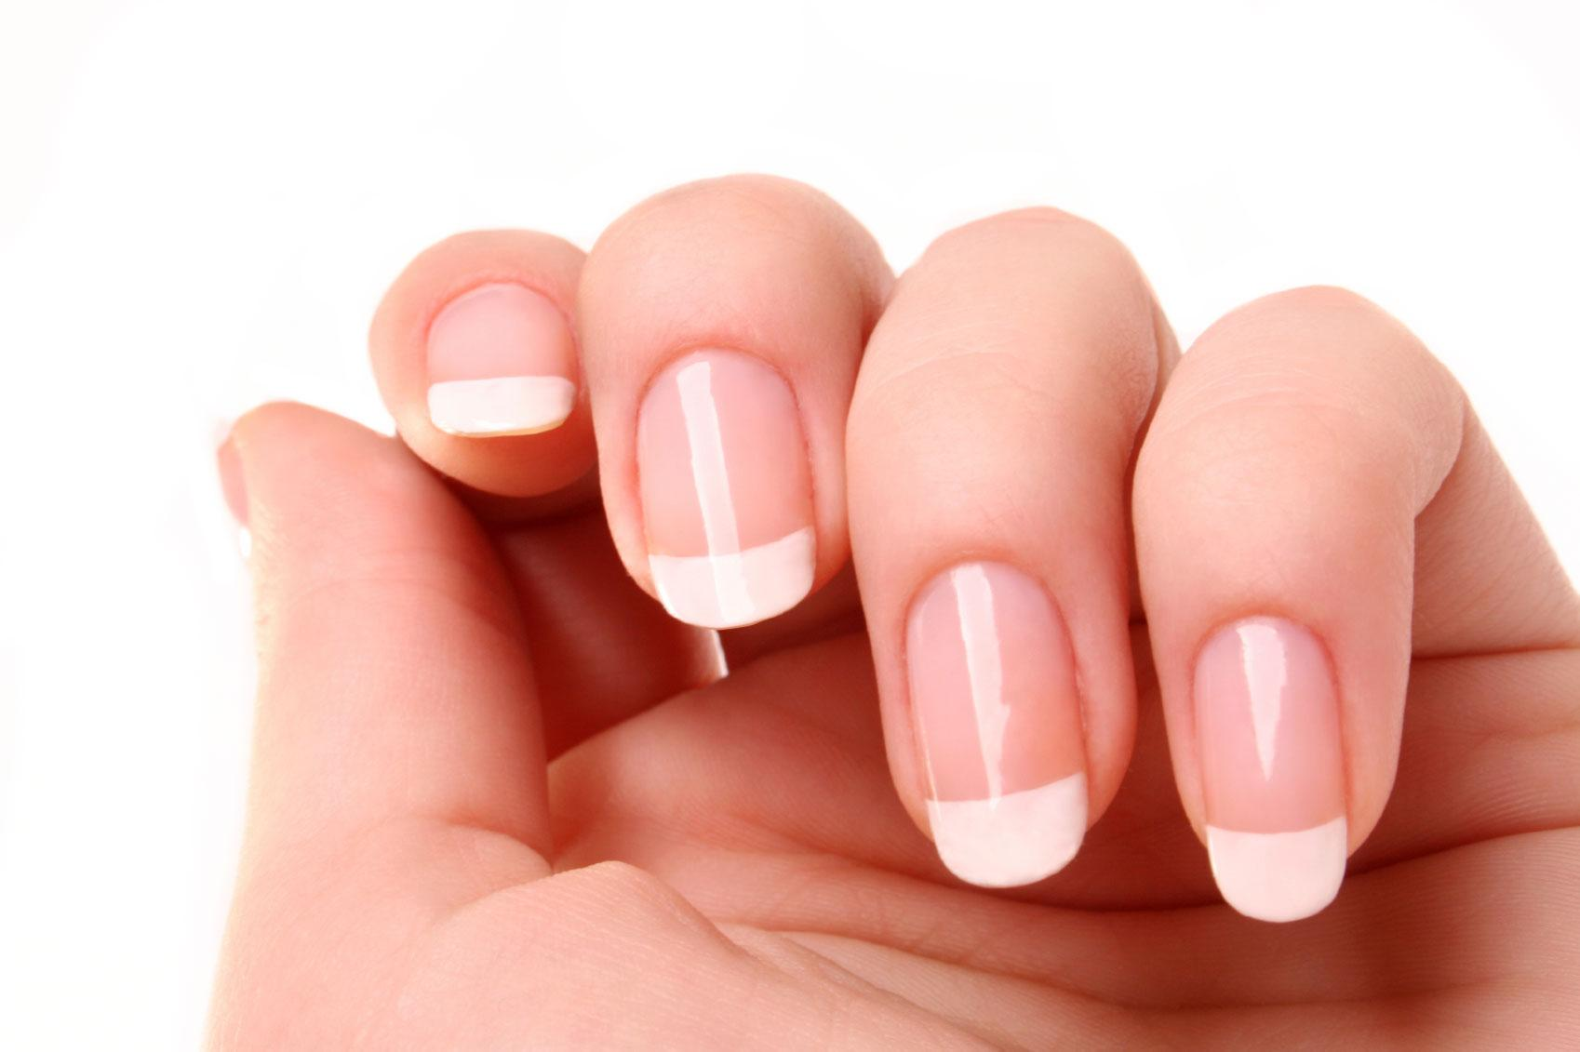

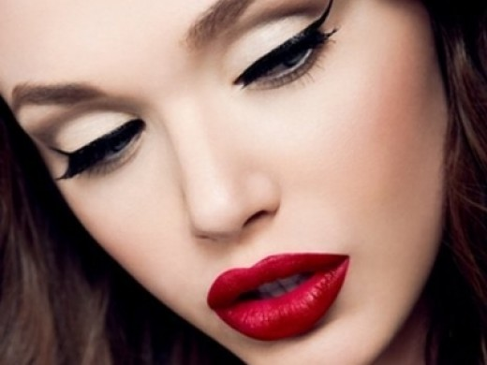

How does it work?
______
______
______
BeautyFIt
Professional
Client
Nails
Makeup
Hair
Time
Waxing
Location

Slide 6
Benefits
Professionals
Clients
Can earn extra money
Can manage their own schedule
No boss overseeing
Meeting new people
No need to wait
Affordable prices
High Quality service
Easy to use
Convenience

Slide 7
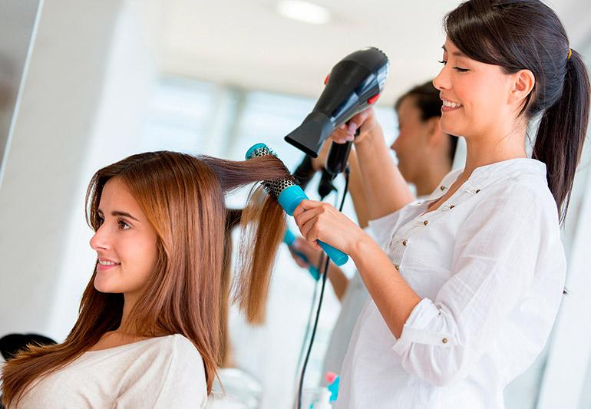
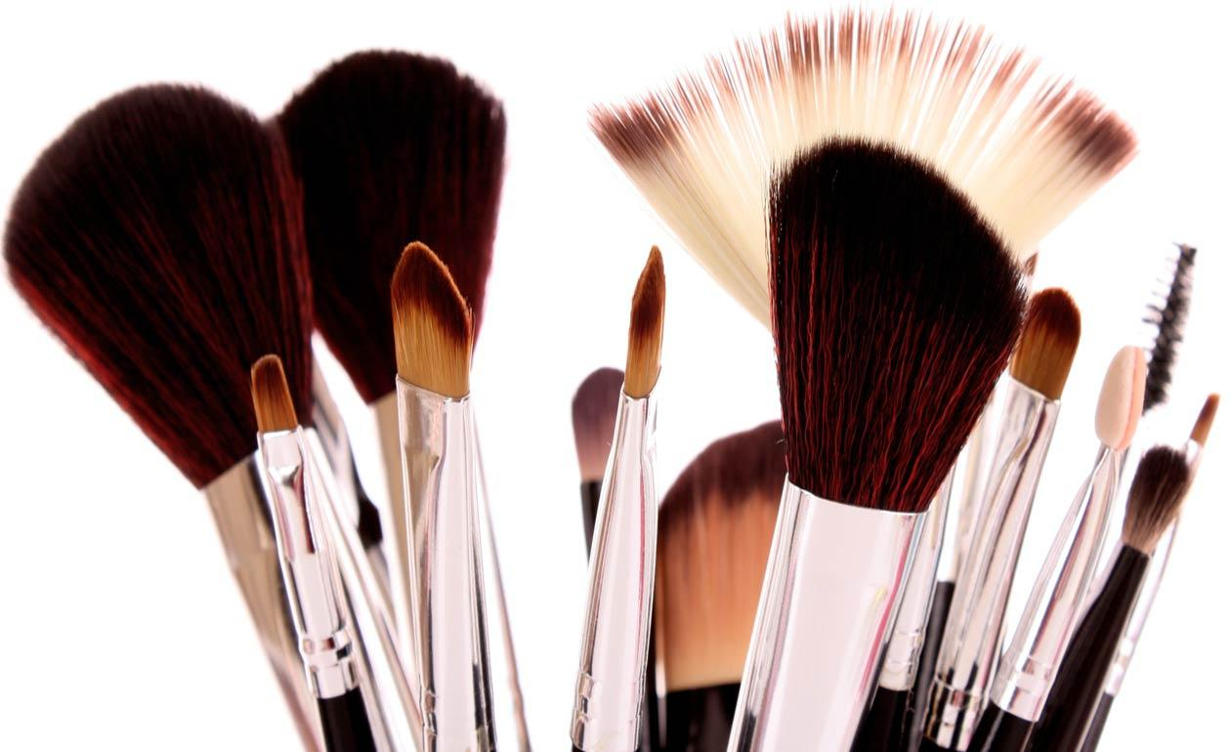

How do we ensure quality?
Service
Materials
Brands
Stylists are not trained by BeautyFit
A Beauty School will ensure the Stylist is certified
Customer can rate the beauty professionals and write reviews
Stylists will use disposable materials for waxing, nails, and makeup
BeautyFit will provide the beauty materials
BeautyFit will partner with beauty brands

Slide 8
Our Partners
Beauty Schools: will certificate our professionals to guarantee a high quality and professional service.
Why would they want to partner with us?
Brand visibility More costumers
Beauty Brands: will provide high quality beauty materials at a lower price to BeautyFit.
Why would they want to partner with us?
Brand visibility Advertisement
Notes:
Beauty schools → more costumers, because all of our professionals will be certified by them
The beauty school has the cosmetology course, which covers hair design, skin care, makeup, etc. The company would be willing to give smaller and specific courses or only applying exams to certificate people, but by a good price and conditions. We can partner with Beauty Schools so they certificate our professionals and in exchange they would get many clients (the professionals would not have to take the whole course, they could just do an exam to get the certification, or just take smaller courses.
Beauty brands → there will be many people using their products, professionals and clients; we will advertise the brand
The salons buy the products from specific brands by a cheaper price, and by using it in the salon they brand the product. If the salon wants to sell the products, they get a commission by selling them. By having sponsors for the beauty products, we can get them by a cheaper price and sell them to the beauty professionals. By doing this, the brand will be used by many professionals in different clients, which is very interesting for them, considering what happens in the salons.

Slide 9

Direct Competition
Offers: Makeup, and Hair
Works from 6am to 9pm
Prices
Makeup | $75-$115
Hair | $50-$85

Slide 10





Indirect Competition
Notes:
The salons above are examples of hair salons, which are our indirect competition

Slide 11




How we differentiate from competitors?
We work 24h
Professionals can manage their own schedule
Higher availability
Lower prices
Notes:
Lower prices than competitors
Availability → there will always be a professional close to you; the client will be able to book an appointment with no advance

Slide 12
What is our greatest risk?
Client insecurity issues
How will we overcome this risk?
Guarantee quality through the Beauty Schools certification and through well known Beauty Brands materials
Professionals will go through a strict selection process and extensive background check

Slide 13





Bloggers
Marketing
Instagram influencers
Campus Reps

Slide 14
Sources of Revenue
1
Transaction fees:
BeautyFit will earn a fee from every service a professional provides.
70% of selling price goes to professionals as compensation.
Avg. Price Per Service In Year 1: $15
Rises to $20 by year-end
Avg. Price Per Service in Year 2: $20
Rises to $23 by year-end
Membership fees:
Each Stylist will pay a membership fee, which includes material needed to perform the service and a T-shirt they can wear and materials.
Price and structure to be determined in year 3.
2

Slide 15
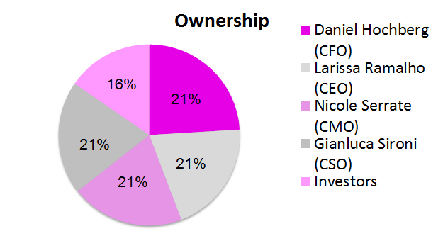
Ownership
If a founder leaves the company, the company has the has the right to buyback the shares.
If the company does not want the shares, they can be sold to outside investors
If new investors are added, the equity percentage of each member will be deducted equally.
16%
21%
21%
21%
21%
Notes:
Tie breaker → investors

Slide 16
Financial Projections
BeautyFit seeks $320K for 16% of the company.
*based on future earnings, differentiation and scalability
CHANGE FOR THE NEW GRAPH
Valuation
of $2M*

Slide 17
Where Will The Money Go?
Initial Investment
$320,000
Marketing and Customer Acquisition
Professional Compensation
Office and other Operating Expenses

Slide 18
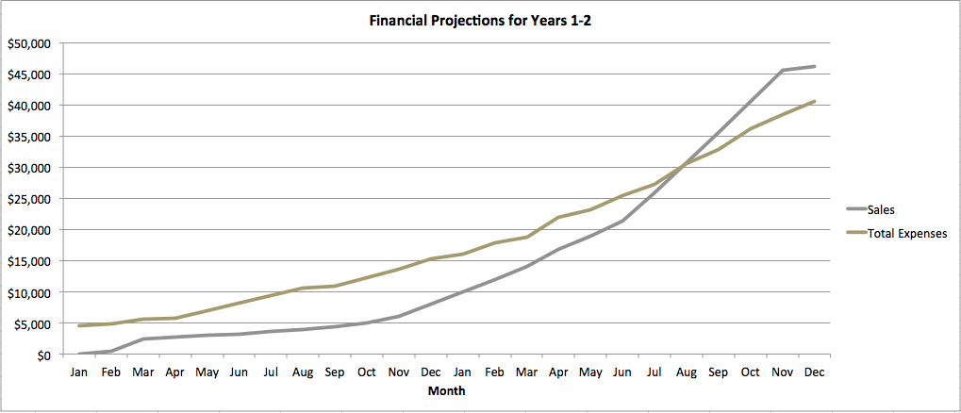
When Do We Become Profitable?

Slide 19
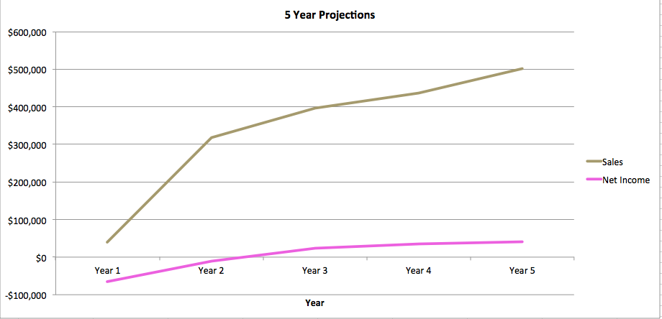
When Do We Become Profitable?

Slide 20
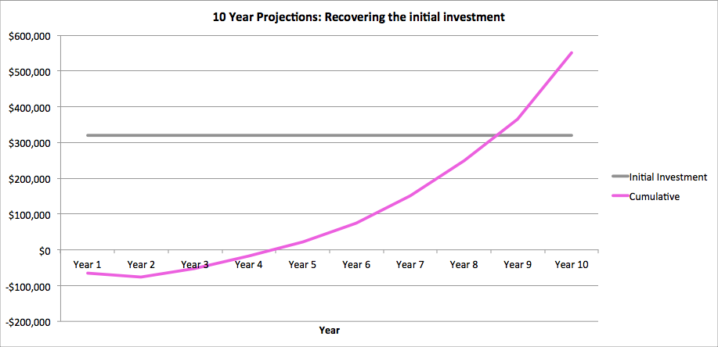
Financial Projections
Depending on Network Effects and competition it will take about 8 to 10 years to recover the initial investment

Slide 21


How Will We Fuel Growth?
Network effects
Entering new markets: New York and Miami
Referral program
Notes:
Referral program: if you refer a new user by providing her a code (like Uber does), both clients will earn $30 credit

Slide 22
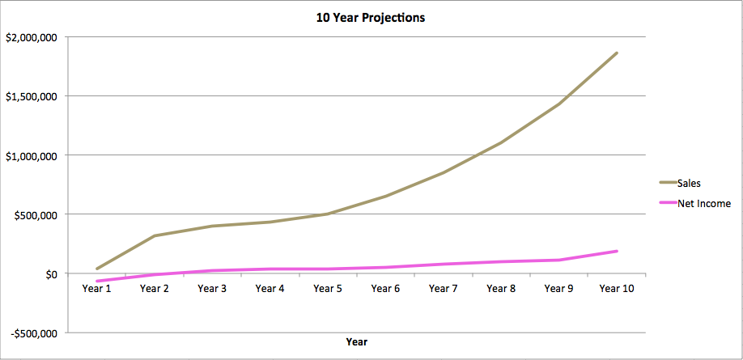
Financial Projections
Growth objective: $500K in Sales by year 5, and $1.5M in sales by year 9

Slide 23
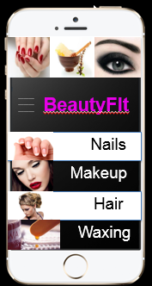
BeautyFit
BeautyFit seeks $320K for 16% of the company
Convenient prices
Convenient times
Convenient places
High Quality
Partnership with beauty schools and beauty brands

Slide 24
Thank you!

